Slide 1
Application development
Sw601f12-PARROT
Pictograms Assisting with Rhetoric Reasoning Or Talking.

Slide 2
Multi Project
Multi project
Target group
Guardians
Children with ASD
Development method
Agile and scrum
Our development method.

Slide 3
Multi Project cont.
Problem definition
How can we ease the daily life for children with ASD and their guardians, while complying with the study regulation?

Slide 4
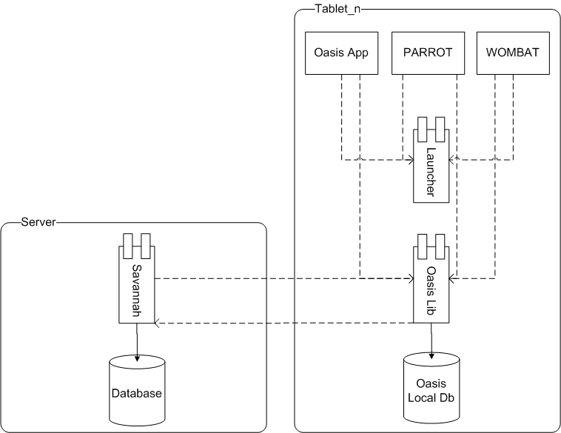
Multi Project cont.
System description.
PARROT

Slide 5
Analysis
Pictograms
Folders
Creating pictograms

Slide 6
Application Design
Like the real thing
Blue folder of pictograms => speech board
Folders of all pictograms => manage categories
Safe
Simple
Easy to remember
Extending pictograms(picture, text, sounds)

Slide 7
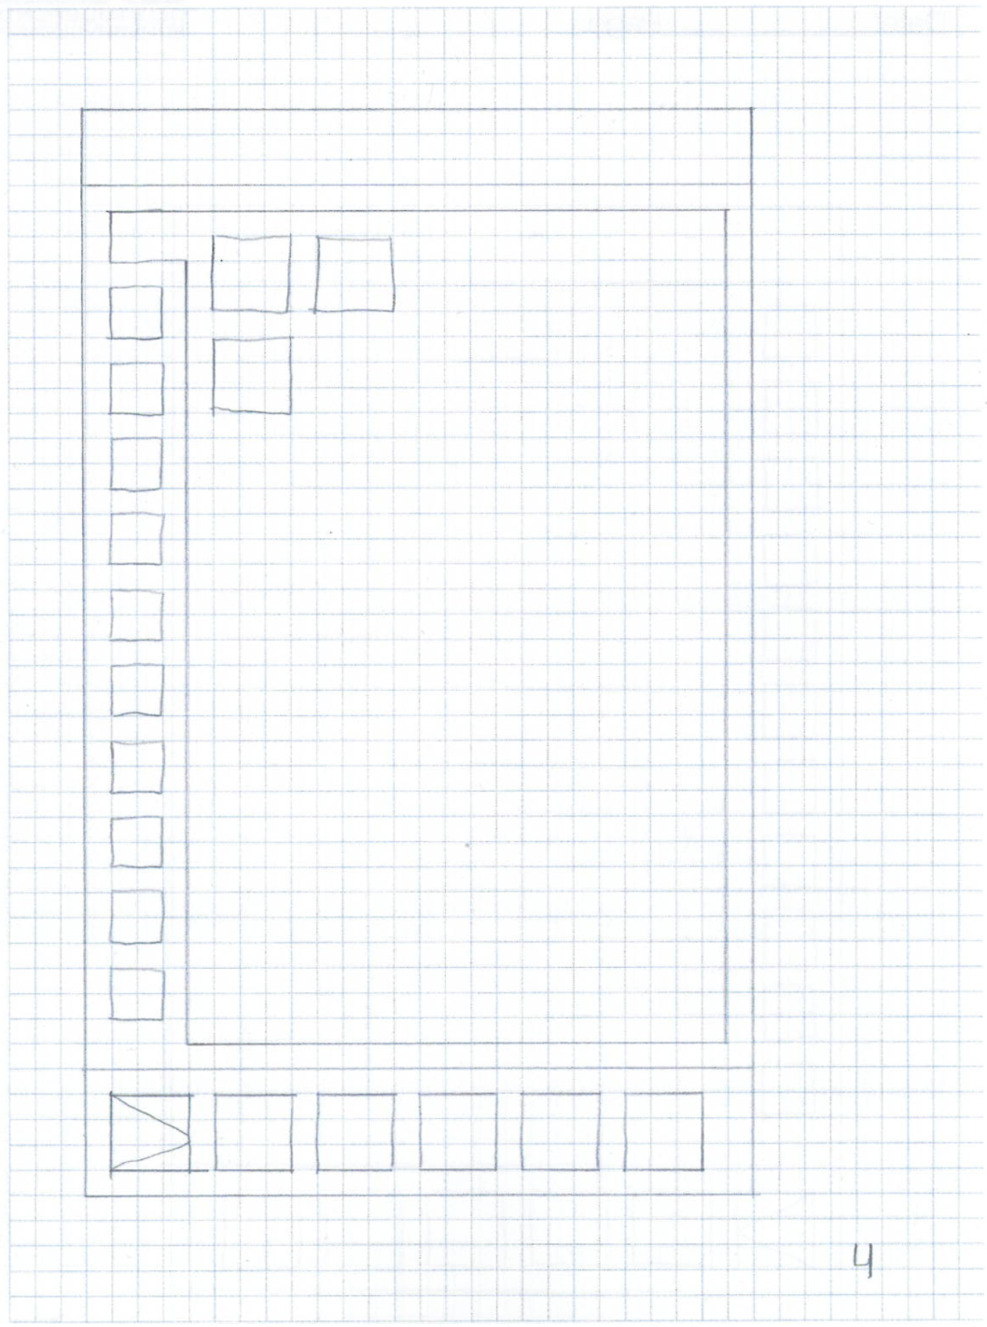
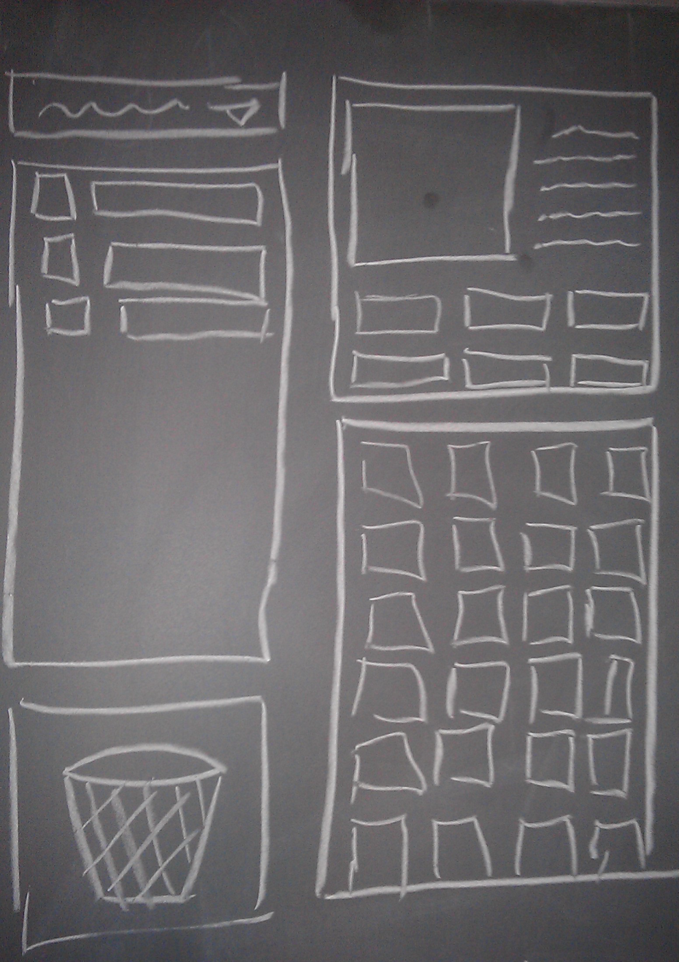

Slide 8
Implementation
Features/functions
Functional GUI
Pictograms: Viewing and Playing
Categories: Creation and Customization
Color Customization

Slide 9
Features we want
Getting PARROT Fully Integrated into Giraf
Adding Pictograms Proper
More Options and a way to access them easily
Sub Categories.

Slide 10
Testing
Ad-hoc testing
Quality improvement on the run.
Dynamic Black box testing
Quality assurance according to the specification.
Usability testing.

Slide 11
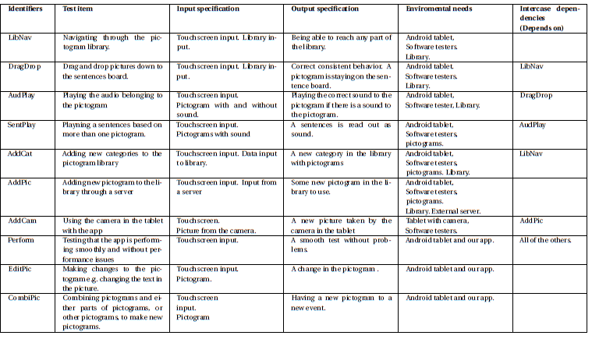
Dynamic Black box testing
Quality assurance according to the specification.

Slide 12
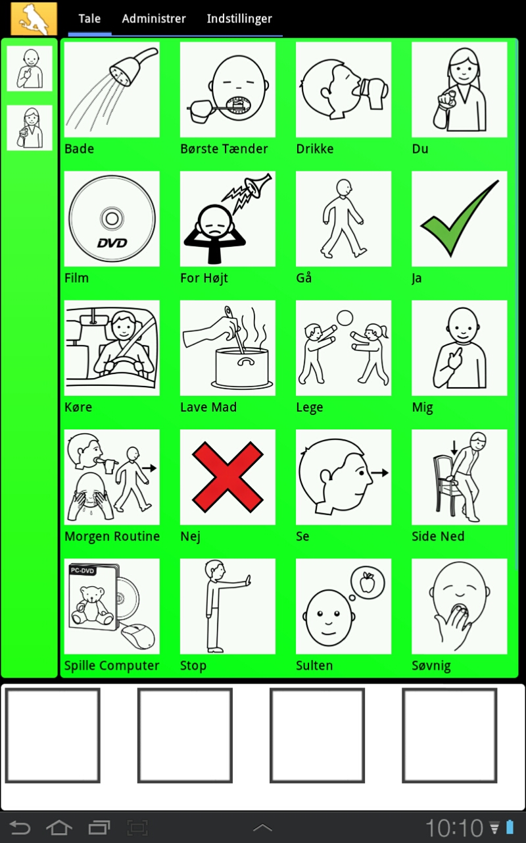

Slide 13
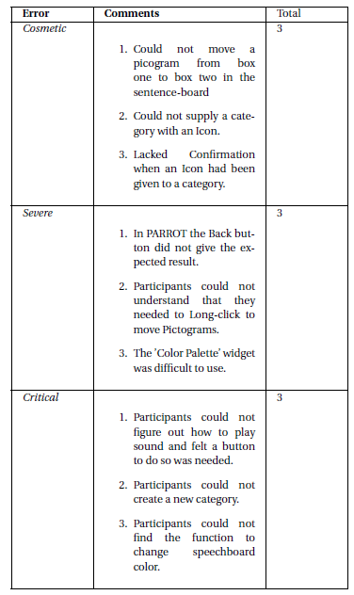
Usability testing

Slide 14
Epilog
Product
Multi project
Agile /Scrum
Future work.

